Slide 1
Imagine that you are in 2030 and the world is progressing at a rapid pace.
Identify a potential problem in this world and solve it using an innovative product of the future.
[Ayush Agarwal]
[20095021]
[ayush.agarwal.ece20@itbhu.ac.in / ayush.ag.05@gmail.com]
[9112647721]

Slide 2
What do you think will be a 2030 problem and why do you think so?
Who will you solve for first and why?
What part of the problem will you solve for first and how will you solve it using the tech of tomorrow?
Comment on the feasibility of your solution by 2030.
How will you measure the success of your product and what are the potential pitfalls in your solution?

Slide 3
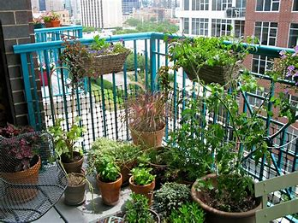
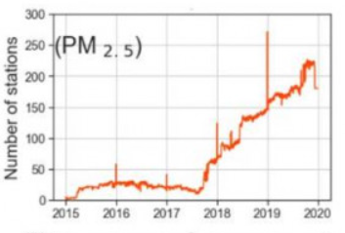
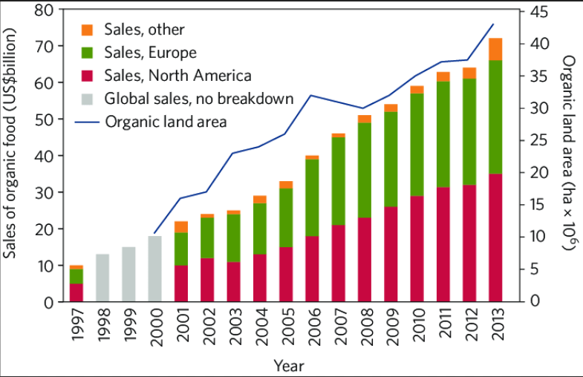
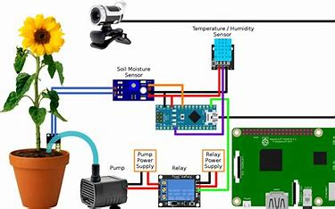
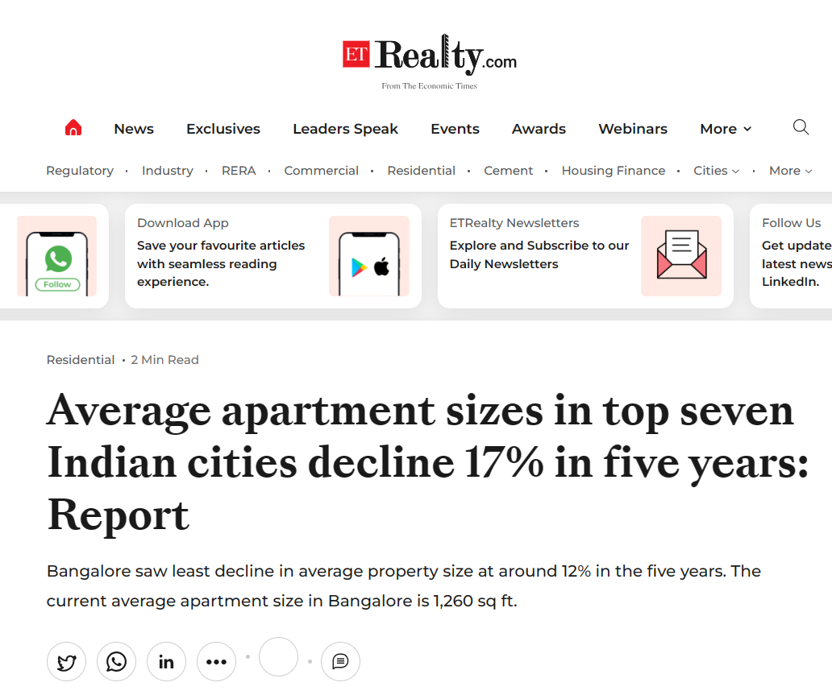

Structuring the Problem !!
A problem well defined is a problem half solved !!
PROBLEM = Tacking challenges to urban indoor gardening and farming in 2030.
Upcoming Challenges -
Why is indoor gardening an attractive market in 2030 ?
Low Area Design -
Continuous decrease in Air Quality =>
More people looking for Air purifying systems
“Futuristic Gardens for futuristic homes” – Designing gardening/farming solutions taking lesser area
Increased public interest in organic produce along with increased awareness of ill effects of pesticides =>
indicating future increase in this market sector
Difficult in Maintenance -
With faster lifestyles of upcoming generations, maintaining a decent sized farm would be considered tedious by many
Avg House Sizes decreasing in Indian Cities =>
Leading to lesser space for indoor gardening and farming
References – [1] [2] [3]
People Don’t Know What They Want Until You Show It To Them – Steve Jobs

Slide 4
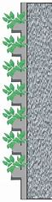
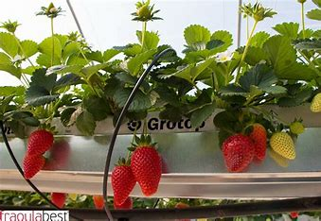
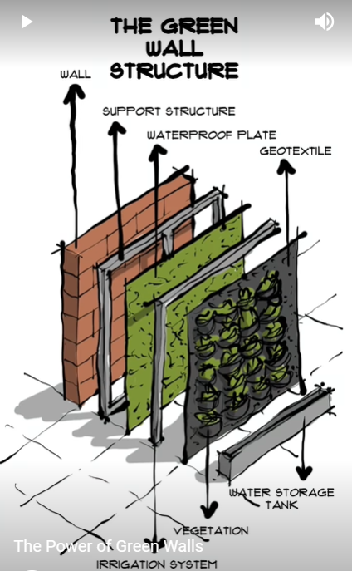
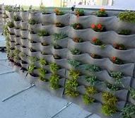
Solution to Part 1 of Problem -
Problem – Low available area
Solution – Vertical Farming system
Feasibility :
Additive Manufacturing will get cheaper with time, 3D printed construction is already invented as of 2023.
With cheaper 3D printing, we could just print a “green tile” and nail it to the wall.
These are the flower pots of the future.
It also becomes easier to design holes for water and wires which will help in the automation part
Technical Aspects :
Side View
Hydroponic based solutions
What’s in it for customers :
Area efficient – vertical gardens have more number of plants for same amount of area at home.
Convenience – Having a garden is as easy as buying a photo frame and nailing it to the wall
Aesthetics – Because who doesn't love a calm soothing green wall
Variety of Fresh produce – customers can choose to grow herbs, strawberries, bananas, lettuce etc that too organically.
Green Walls – a structural design
Rough view of the final design

Slide 5

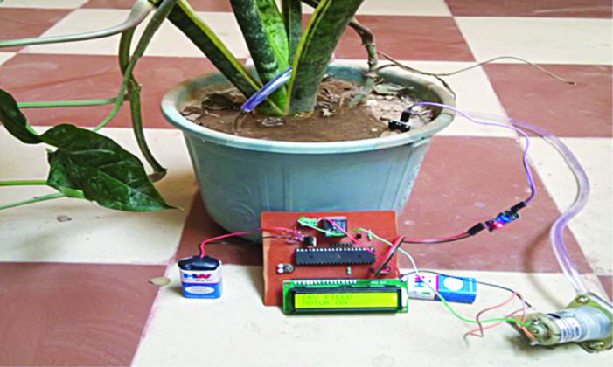
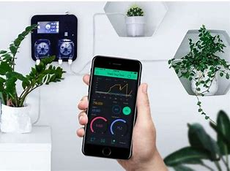
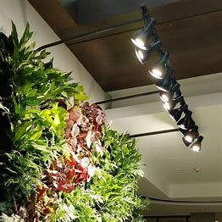

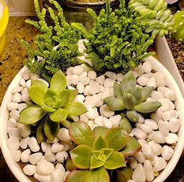
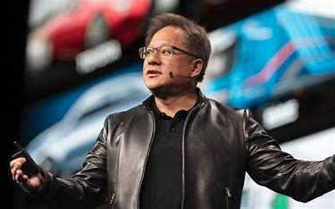
Solution to Part 2 of Problem -
Problem – Difficulty in Maintenance
Solution – Pre-installed IoT and AI based automation
Technical Aspects :
What’s New :
Mechatronic Automation of farming has been long since existed,
However all the presently available market products require tedious installation process by users thus proving to be a customer acquisition barrier (CAB)
Our wall based structure would have pre-installed Drip irrigation and artificial lighting systems, thus providing convenience to users.
Smart Lighting
to ensure growth
Pebbles to avoid mosquitoes
Moisture detection based drip irrigation system
Plant health monitoring IoT systems
What’s in it for customers :
“The garden takes care of itself” – our future customers.
Feasiblity :
With rise of technologies such as Mechatronics, IoT and AI, automation electronics tools are likely to get more affordable by 2030
With more and more data available with time, ML based plant health monitoring is a significant possibility.
“The solution is ready, the problem isn’t.” - Jensen Huang

Slide 6



Measuring out Success, The Metrics and the pitfalls -
L1 Metric
North Star Metric
Hardware Failure Rate
= total # of device failures / total population of devices shipped and in service for the period of interest.
Gross Profit Margin
= Revenue – COGS (Cost of goods sold)
Potential Pitfalls –
“Gardening and Indoor Farming” is still a niche, growing sector - “ We might serve the world’s best oranges but there will still be people who don’t prefer oranges”
Yield – this product is not meant to replace existing farming methods, rather meant to satisfy personal needs. Mis-advertising it in a way to “replace farming” could lead to disappointed customers
Flammable Hazard – Can cross sell an automatic fire extinguishing system along with it
Growth Metric
Customer Acquisition Rate (CAR)
= Difference in number of First Time Customers (FTC) from this month as compared to last month
“We can make the best product, but there will be people who don’t like it.” - Steve Jobs

Slide 7

Thank You !!
”There is beauty in simplicity; fewer slides can often convey more.“ – Ayush Agarwal (yeah that’s me ;)

